Slide 1

Post Malone Songs Analysis
Team Name: Sai Teja Ki Team
Members:
Aayush Chaturvedi - Aayush.Chaturvedi@adypu.edu.in
Veeramalla Saiteja - veeramalla.saiteja@adypu.edu.in
Ashvin Tiwari - Ashvin.K@adypu.edu.in
Abhinav Vinod Bhusagare - Abhinav.Bhusagare@adypu.edu.in
Notes:
‹#›

Slide 2

Analysis Of PostMalone Data Set
This presentation explores a detailed analysis of Post Malone songs dataset, covering metadata such as song titles, albums, release years, and song lyrics. The analysis includes various statistical and linguistic examinations to uncover patterns in release timing, lexical diversity, and word usage. The dataset contains 148 entries with fields on song title, album, year, release date, and lyrics.
Notes:
‹#›

Slide 3
Dataset Overview and Zipf’s Law Concept
Descriptive Statistics
Zipf’s Law Analysis
The dataset features 148 songs spanning 7 albums over 8 years, from 2013 to 2020. Basic summaries include year distribution averages and unique counts of songs and albums, providing foundational insight into data scope and balance.
Zipf’s Law states that in natural language the frequency of any word is inversely proportional to its rank in the frequency table. The analysis cleans lyrics text, counts word occurrences, and ranks them to assess conformance with this linguistic law.
Notes:
‹#›

Slide 4
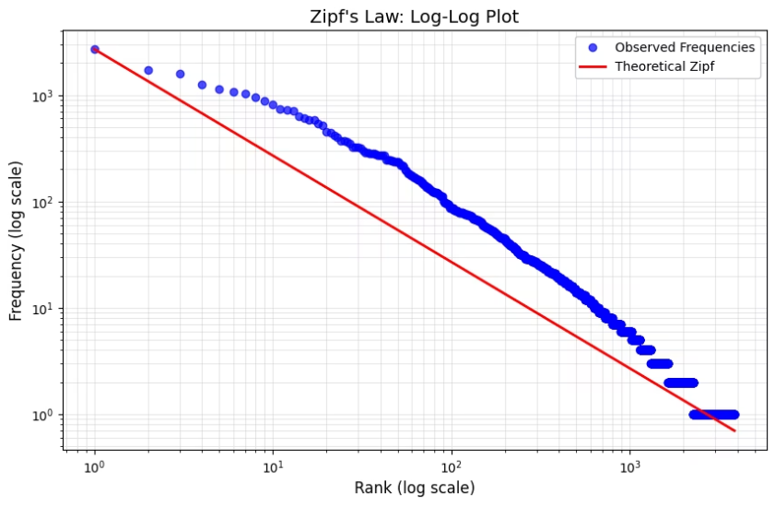
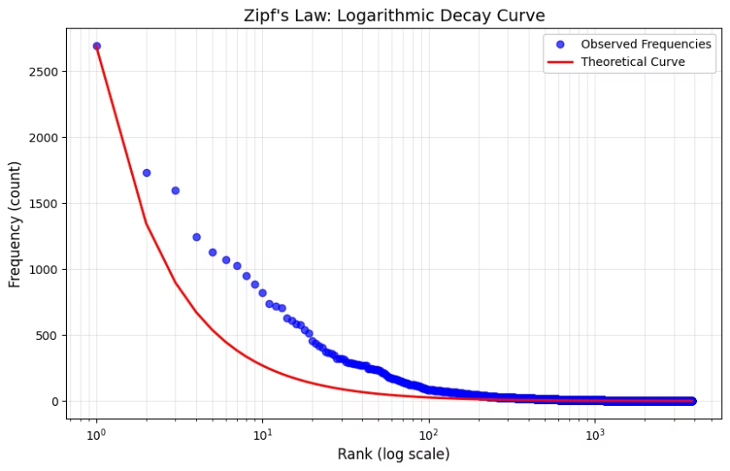
Zipf’s Law Visualizations
Log-Log Plot
Logarithmic Decay Curve
The log-log plot compares observed word frequencies with the theoretical Zipf distribution. Points of observed word rank versus frequency align closely with the expected inverse curve, validating typical language usage patterns within lyrics.
A linear-scale frequency plot with logarithmic x-axis rank highlights how high-ranking words dominate counts, while lower ranks sharply diminish, illustrating linguistic economy in lyric composition.
Notes:
‹#›

Slide 5
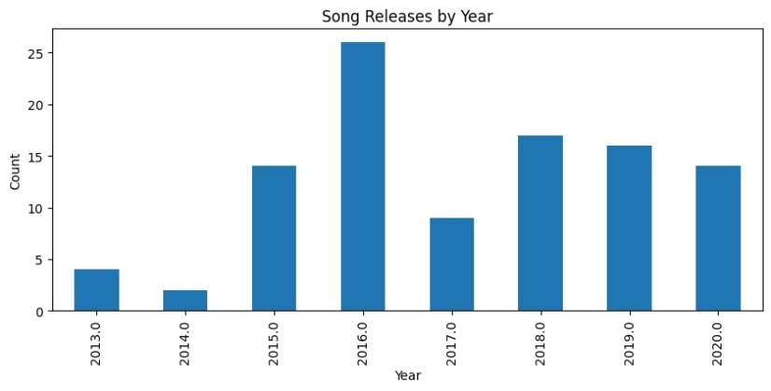
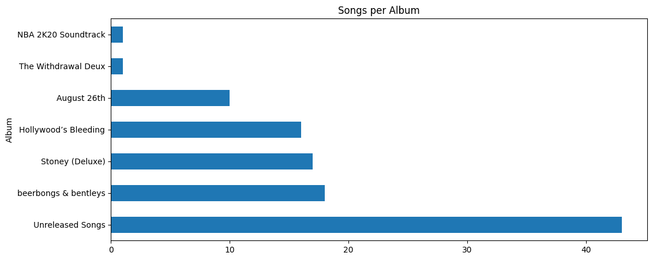
Distribution of Song Releases over Time and Albums
Yearly Release Trends
Album-wise Song Counts
The bar chart demonstrates fluctuations and peaks in song releases across years. This temporal spread reveals major activity phases in Post Malone’s career, especially around albums released from 2015 to 2019.
Songs per album vary significantly, indicating artistic focus and output intensity. This distribution aids understanding of production emphasis and album impact in dataset composition.
Notes:
‹#›

Slide 6
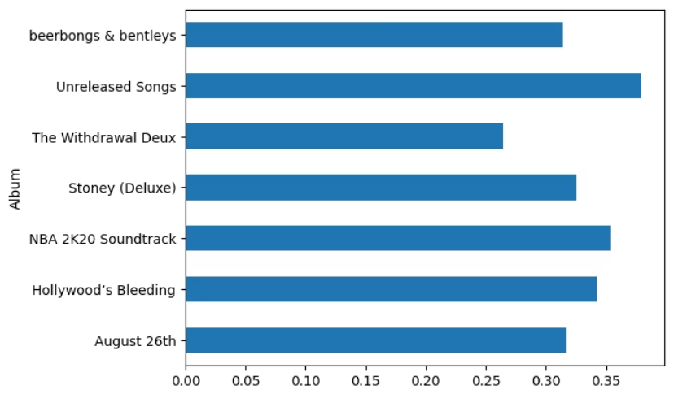
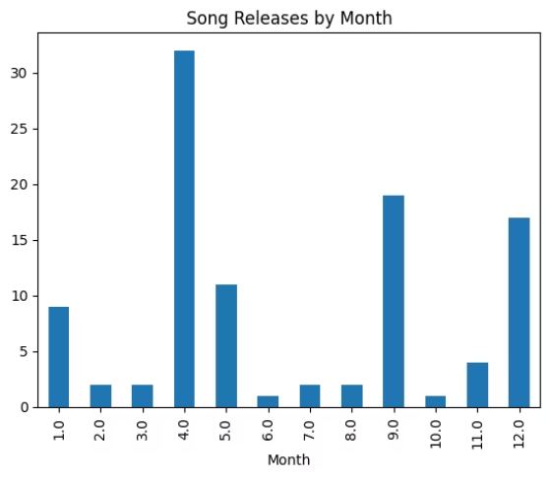
Lexical Diversity and Preferred Release Months
Vocabulary Richness
Song Releases by Month
Analyzing lexical diversity per album quantifies vocabulary variety as a measure of lyric complexity. Variations among albums suggest evolving songwriting style and thematic diversity.
Song releases are not uniformly distributed monthly, indicating possible seasonal patterns in production or marketing strategies. Months with peak releases may correlate with promotional cycles.
Notes:
‹#›

Slide 7
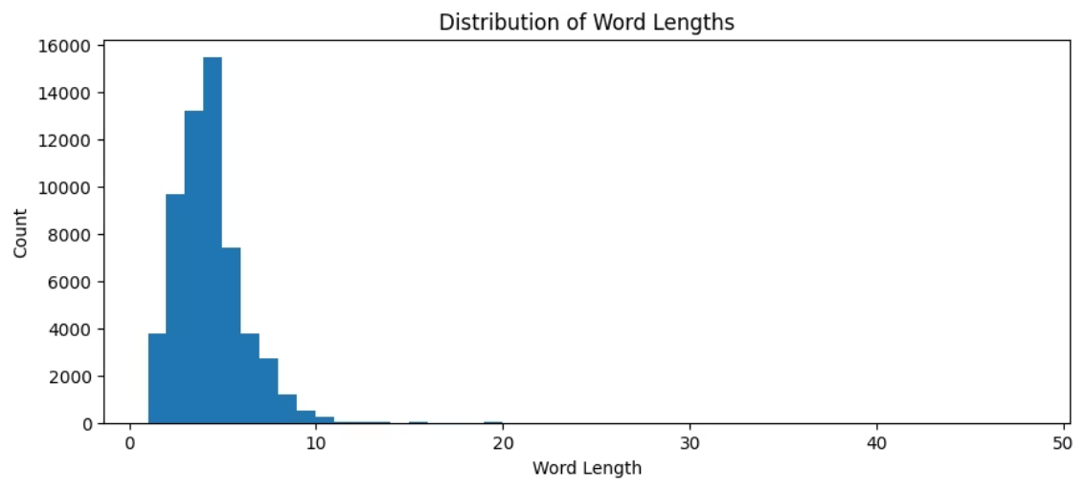
Word Statistics and Word Length Distribution
Key Metrics
Total words in all lyrics exceed 58,000, with nearly 4,000 unique words. On average, each song contains about 393 words, reflecting rich lyrical content suitable for detailed text analysis.
Word Length Distribution
The distribution histogram shows that most words fall within short to medium-length ranges, a pattern typical in song lyrics that balances rhythm, rhyme, and clarity.
Notes:
‹#›

Slide 8
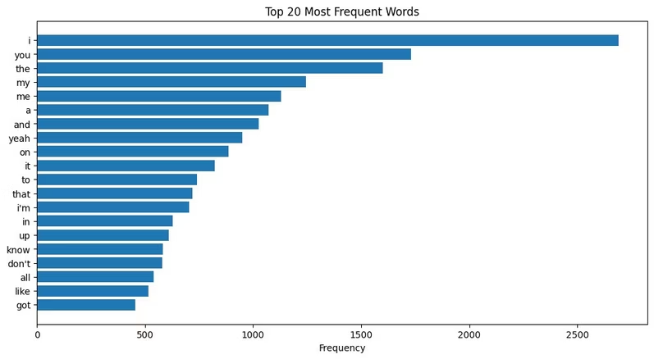
Top 20 Most Frequent Words in Lyrics
Common Themes and Language
Zipf’s Law Conformance
The top 20 words include personal pronouns and commonly used English words such as I, you, the, and my, highlighting the personal and conversational nature of the lyrics.
The frequency distribution follows Zipf’s expectation, affirming normative linguistic structure. This is characteristic of natural language texts including artistic song lyrics.
Notes:
‹#›

Slide 9

Contribution
Python Notebook Creation and Dataset Cleaning:
Aayush Chaturvedi
Veeramalla Saiteja
PPT Creation and Designing
Ashvin Tiwari
Abhinav Vinod Bhusagare
Aayush Chaturvedi
Notes:
‹#›

Slide 10

THANK YOU!!
Notes:
‹#›

